Slide 1
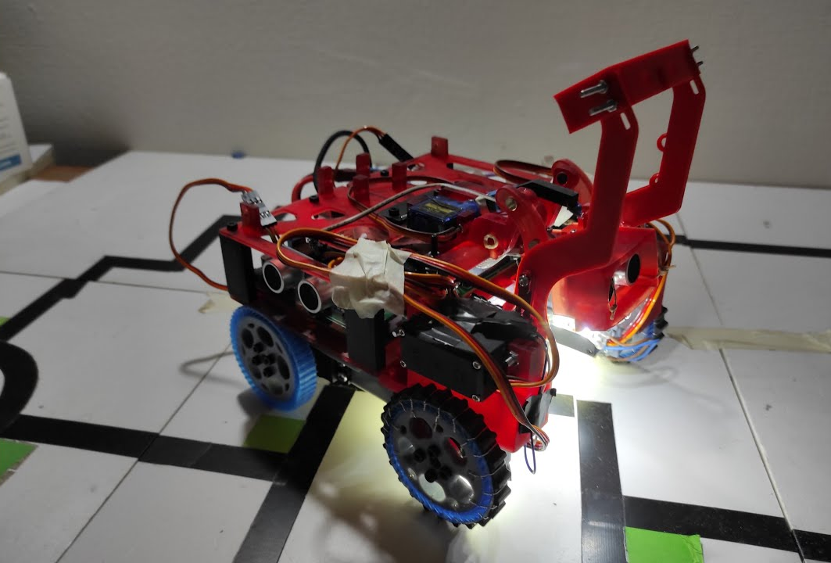
LINE FOLLOWER SOFTWARE
Click here for the video

Slide 2
take a photo (frame) (in a thread)
Flowchart
you can click on every block for more explanations
NO
YES
make some adjustment for better reading
check if gap
check if I cross
difference between left and right black pixels
YES
removing wrong directions
NO
2d control
line in/out tracking
obstacle

Slide 3
take a photo (frame) (in a thread)
THREAD (60 ms tot)
if I use only a thread when I decide to take a new photo I need to wait for about 30 ms to have it ready
single threading
take a photo
30 ms
-taking a photo takes around 30 ms (at 30 fps) -analysing the photo (30 ms)
60 ms total
1/0.06 = 17 fps
analyze image
30 ms
back to flowchart

Slide 4
THREAD 1 (30 ms tot)
THREAD 2 (30 ms tot)
take a photo
30 ms
read image
0 ms
global variable
multi threading
save photo in RAM
analyze image
30 ms
0 ms
-read a photo (0 ms) -analysing the photo (30 ms)
30 ms total
1/0.03 = 33 fps
If the robot uses 2 threads it can have one cycle that is updated every 30 ms to take photos, so it can get access to the last photo shooted in a really short time
back to flowchart

Slide 5
single threading
taking photo
analyzing photo
30 ms
30 ms
AVERAGE INPUT LAG
multi threading
photo waiting in RAM
taking photo
analyzing photo
30 ms
0-30 ms
30 ms
Using multi threading the average input lag increases by up to 50%, but the average frame rate doubles so it’s worth.
back to flowchart

Slide 6
RED
make some adjustment for better reading
HSV filter
GREEN
BLUE
convert to gray
sum a mask for light correction
applying a blur
gaussian threshold
LINE
back to flowchart

Slide 7
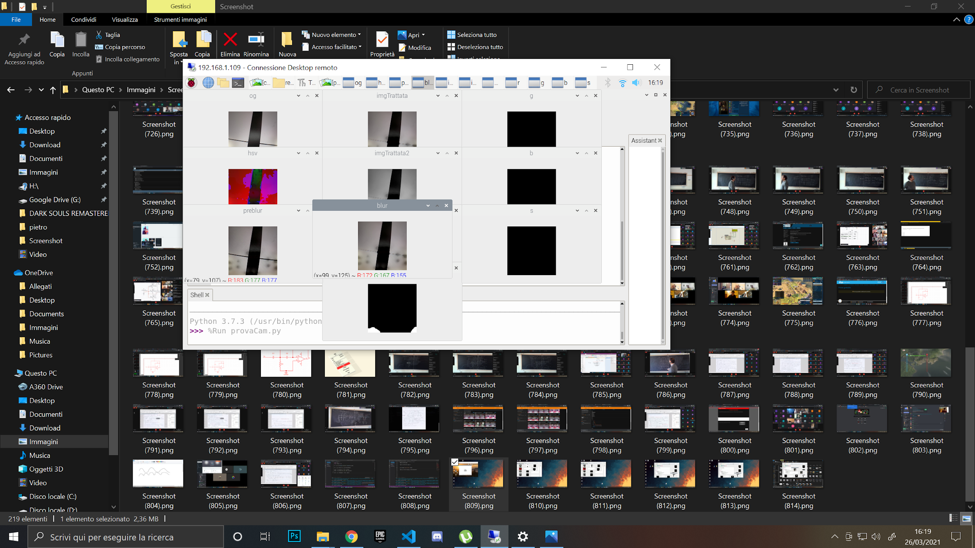
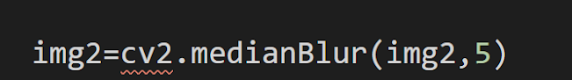
applying a blur
pre blur
We apply a blur to make the image "smoother" and to remove lines between tiles.
post blur
back to flowchart

Slide 8
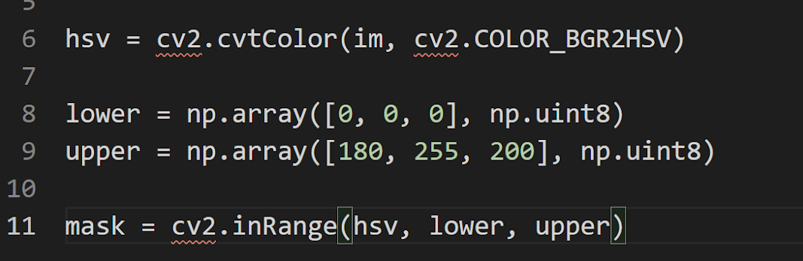
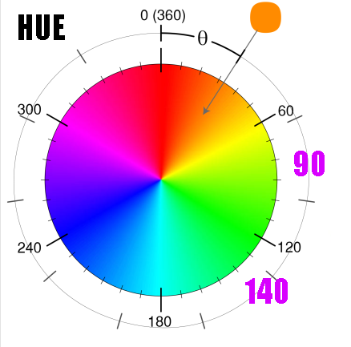
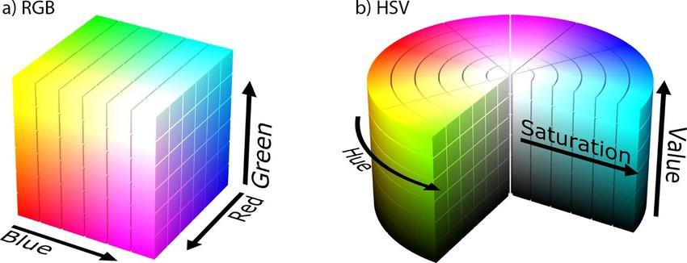
HSV filter
In order to detect a color (for example green) it is easier to use HSV colors instead of RGB. For example, if the robot needs to detect green, it just needs to keep HUE between 90 and 140.
back to flowchart

Slide 9
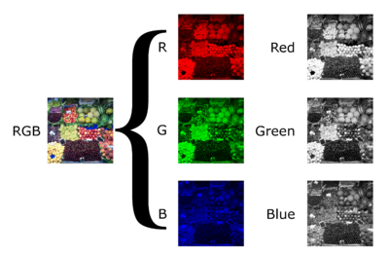
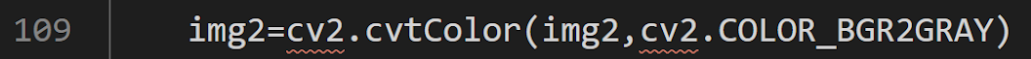
convert to gray
A colored image has 3 times more pixels than a gray image, but when it needs to detect only a line; the robot doesn't need this information, and analyzing a gray image is quicker, so it converts it.
back to flowchart

Slide 10
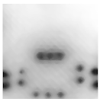
sum a mask for light correction
correcting mask
We have some leds in the robot. Strong light sources are not good for taking a photo, the general image quality is actually better without leds because other light sources like room light are softer and farther.
However, external light sources are unstable and always different, whereas LEDs are always in the same position; this means that we can track it and correct the image.
back to flowchart

Slide 11
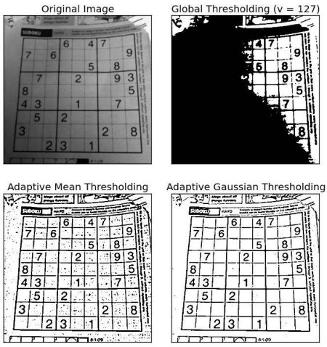
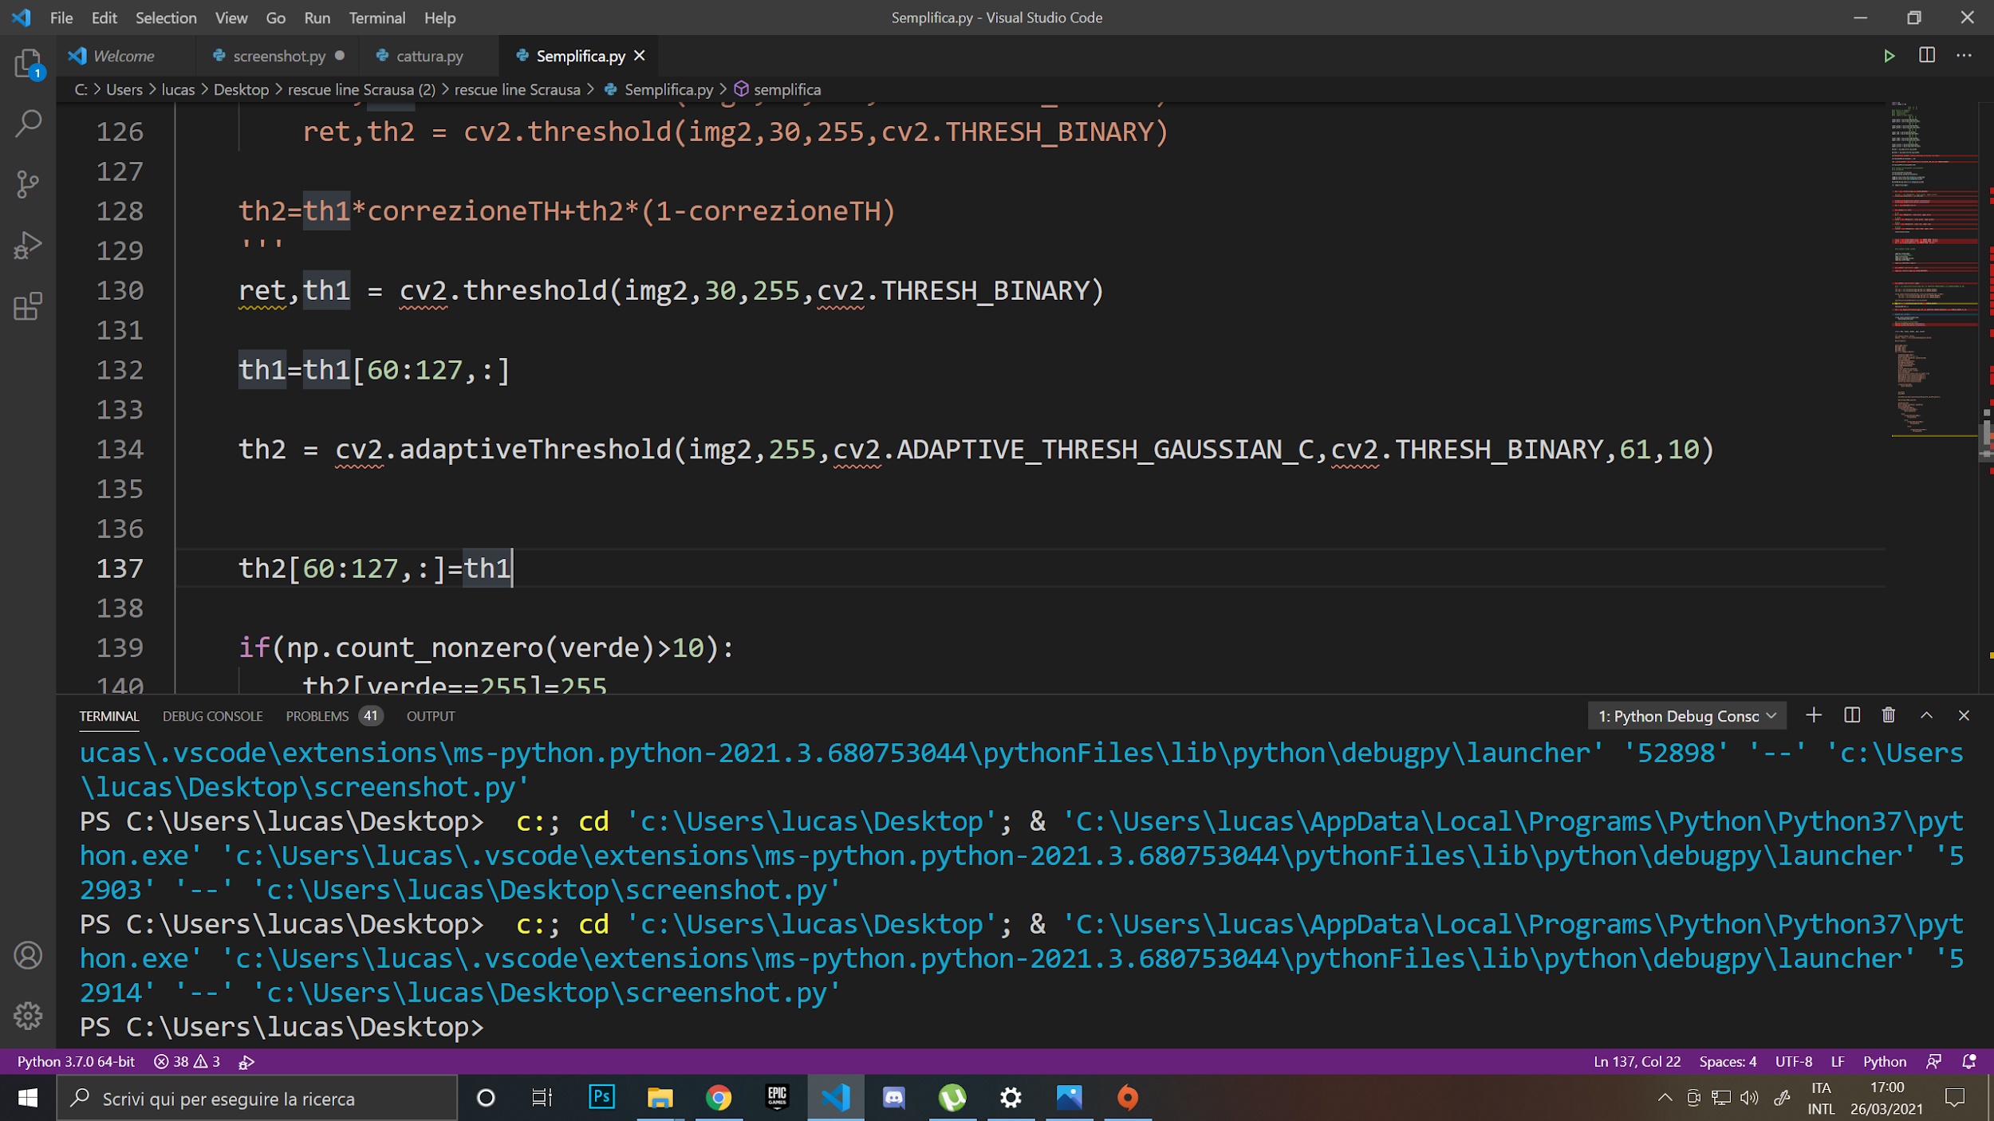
gaussian threshold
In order to split black and white the easiest way is to apply a threshold: if a pixel value is higher than the threshold, it is white, otherwise it is black.
However, this does not work well with pictures that have shadows, so we use a gaussian threshold; in a gaussian threshold every pixel has a different threshold that depends on the pixels around it.
back to flowchart

Slide 12
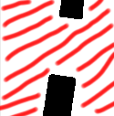


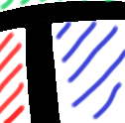
check if gap
check if I cross
In order to detect if the robot is seeing a gap or a cross the number of white areas must be counted:
1 area: gap
2 areas: normal line
3 areas: “T” cross
4 areas: “X” cross
back to flowchart

Slide 13
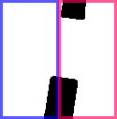
difference between left and right black pixels
The robot makes the difference between the numbers of left and right black pixels, and it uses the value it gets in a proportional control for moving motors.
back to flowchart

Slide 14

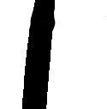
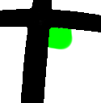
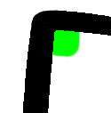

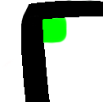
removing wrong directions
The algorithm that analyzes a cross and decides the right direction is the most complicated in this project... i can't explain it only with text and images, so check this video for a full explanation
VIDEO: https://youtu.be/Njx3aAMHUKc
back to flowchart

Slide 15
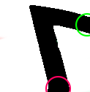
line in/out tracking
OUTPUT
The robot tracks the input and output of the line. In order to achieve such a goal, it detects the black pixels near the position of the line input or output in the previous frame.
INPUT
back to flowchart

Slide 16
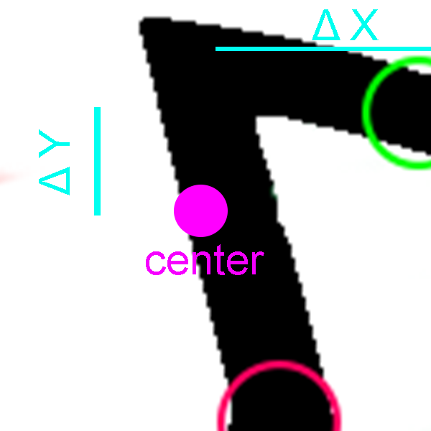
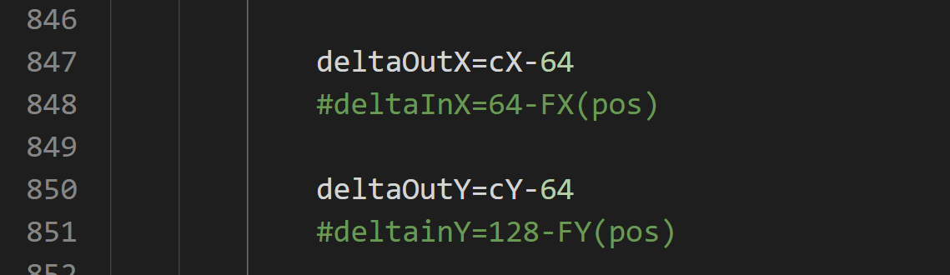
2d control
It makes the difference between the center and the output.
It uses these 2 values to give the correct speed to the motors (in case of gap it uses only ΔX)
back to flowchart

Slide 17
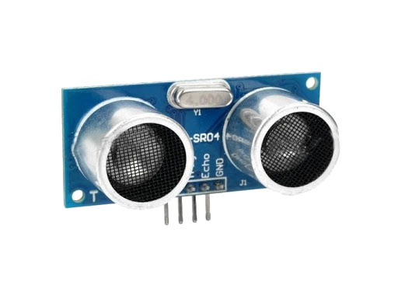
obstacle
In order to detect the obstacle we use HC-SR04 ultrasonic sensors: one is on the front of the robot, and two are on the left and on the right; as a result, they can stay close to the obstacle while turning around it.
While the robot is turning around the obstacle, it checks if it is seeing a line with the camera, and if it sees it, it interrupts the obstacle routine and continues to follow the line.
back to flowchart

